Slide 1



Keep Notes App A Simple and Efficient Note-Taking Experience
Developed by
Adnan Naeem 079
Ali Raza Khan 094
Zain –ul-Abdin 067
Made Using

Slide 2
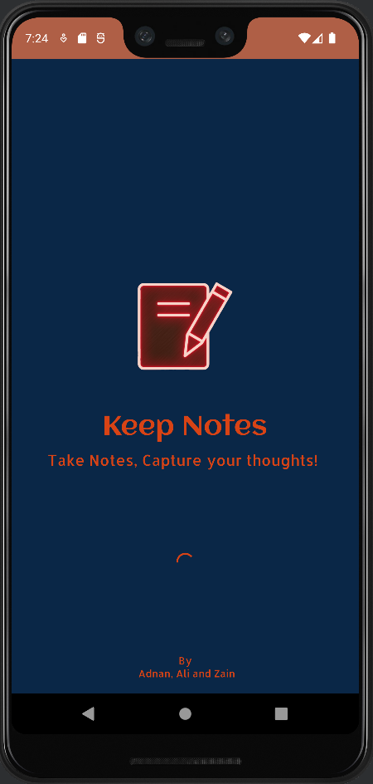
Splash Screen
Engaging splash screen with the app logo and a welcoming design.
Sets the tone for a positive user experience.

Slide 3
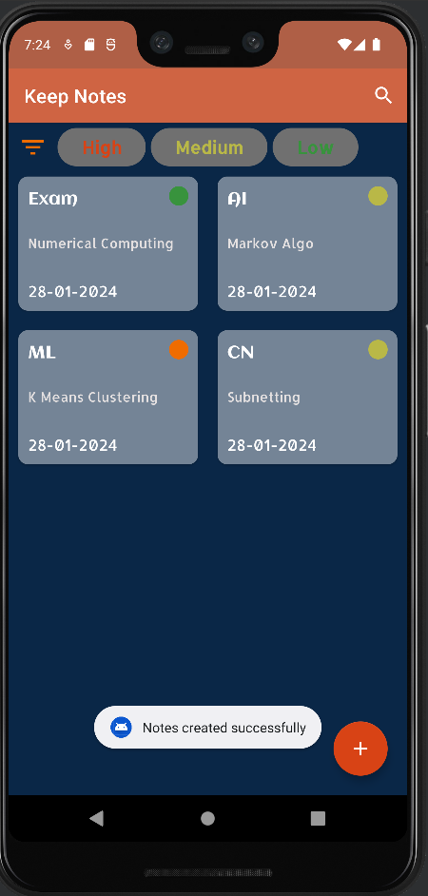
Frag Create Note
Create notes with a dedicated fragment.
Fields for Title, Subtitle, Content, and Color Indicators.
Utilizes a Room database for efficient storage.

Slide 4
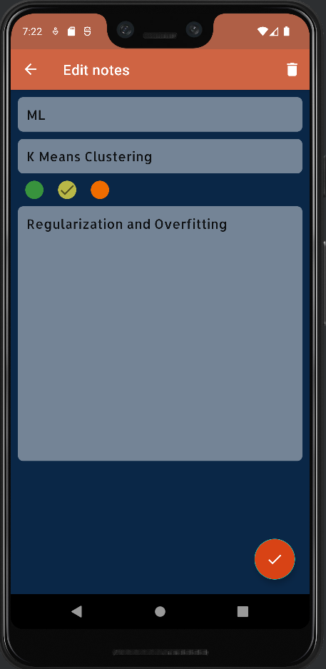
Frag Edit Note
Edit existing notes seamlessly with the Edit Note fragment.
Intuitive interface with fields for Title, Subtitle, Content, and Color Indicators.
Utilizes the same Room database for consistent data management.

Slide 5
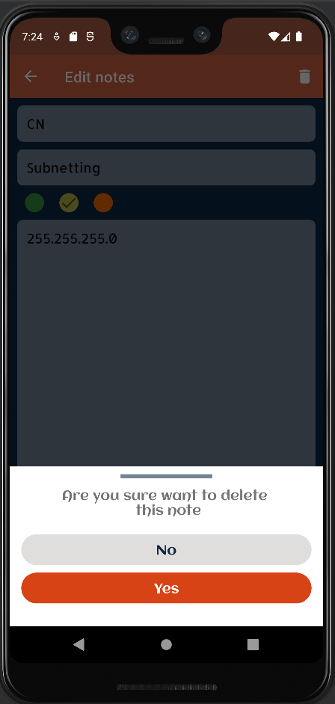
Delete Function
Implemented secure note deletion with a confirmation dialog.
Users can choose to confirm or cancel the deletion action.
Provides a safeguard against accidental deletions.

Slide 6
Any Questions ?

